Slide 1
Knowledge Thread 2 - Session 1
2DX4 Computer Engineering
Joshua Fitzpatrick
Ama Simons

Slide 2
This Studio covers…
Analog to Digital Conversion (ADC) of Signals
Analog to digital conversion of AC signals
Sampling rate, aliasing & Nyquist Criterion

Slide 3
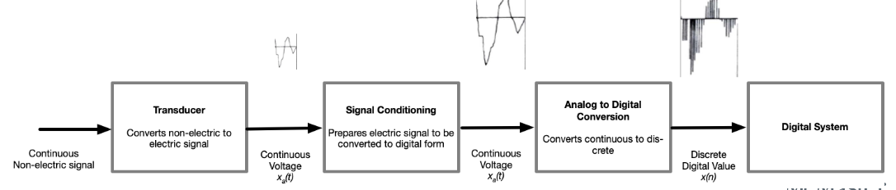
Why are we doing this?
Remember from Lecture:
The signal must be converted from an analog signal to a digital signal to be read by the microcontroller.

Slide 4
You will need …
Analog Discovery (AD2) and Diligent Waveforms 2015 software
AD2 and Waveforms 2015 Reference Manuals
2DX4 parts kit (LMC662 Op-amp, breadboard, AD2, resistors)
Your Microcontroller

Slide 5
Exercise 0 - Revisiting ADC
For this exercise we will return to the 2DX4StudioW20E0_ADCDemo code and examine its use with acquiring a sinusoid. To do this, perform the following steps:
1. Configure the AD2 Signal Generator to output a 1 Hz sinusoid waveform of 1.0Vpp (0 to 1V) on channel WaveForm Generator 1 (Connect GND from the AD2 to GND of the MSP432E401Y).
2. Open the 2DX4StudioW20E0_ADCDemo Keil project, modify the delay to be 500ms total. Translate, build, and load the code on to the microcontroller.
3. Connect WaveForm Generator 1 to MSP432E401Y pin PE4. The time delay results in a 2Hz signal, which is the recommended minimum Nyquist sampling rate.
4. Upon conclusion of the program, you will find 100 samples from the ADC in the array func_debug[] (hint – set Watch 1 up for func_debug prior to running the code, then click the + to see array element content).
5. Select 10s worth of contiguous samples and plot them in excel. There is an Excel file included to assist with the conversion from hexadecimal to decimal. Note your observations.

Slide 6
Let’s begin (DEMO) You have 20-ish mins to complete the first exercise. Come back to general after the discussion

Slide 7
Exercise 1 – ADC Sampling & Aliasing
For this exercise we will extend our findings. You should have observed that Nyquist’s recommended minimum sampling frequency provides less than optimal results if we want to reproduce the shape of the original signal from the raw data.
1. Repeat Exercise 0, except increase your sampling frequency to 10Hz (you will need to calculate a new time delay).
2. Select 2s worth of contiguous samples and plot them in excel. There is an Excel file included to assist with the conversion from hexadecimal to decimal. Note your observations.
3. Repeat the exercise at 10Hz sampling frequency, except increase your input sinusoid frequency to 40Hz.
4. Select 2s worth of contiguous samples and plot them in excel. There is an Excel file included to assist with the conversion from hexadecimal to decimal. Note your observations.

Slide 8
Let’s begin (DEMO) You have 20-ish mins to complete the second exercise. Come back to general after the discussion

Slide 9
Discuss (in your Tables)
1. When sampling at the Nyquist minimum sampling frequency, what is maintained from the original signal?
2. The Nyquist minimum sampling frequency is 2x the frequency of interest. When sampling at 10x the frequency of interest, what is one property of the original signal that is better maintained than at Nyquist?
3. What challenges does this implementation pose for further development? (consider how much "free time" the process has to do other things and still maintain the sampling frequency)

Slide 10
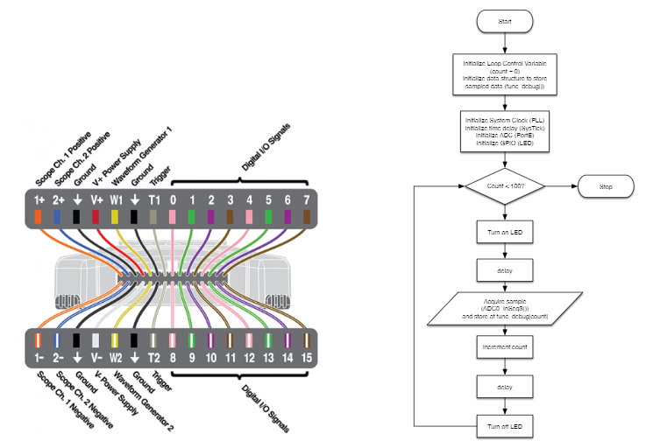
Reference Info

